Slide 1




GLENDALE COMMUNITY COLLEGE
Team 1

Slide 2
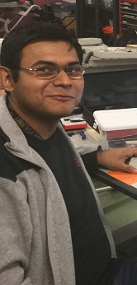
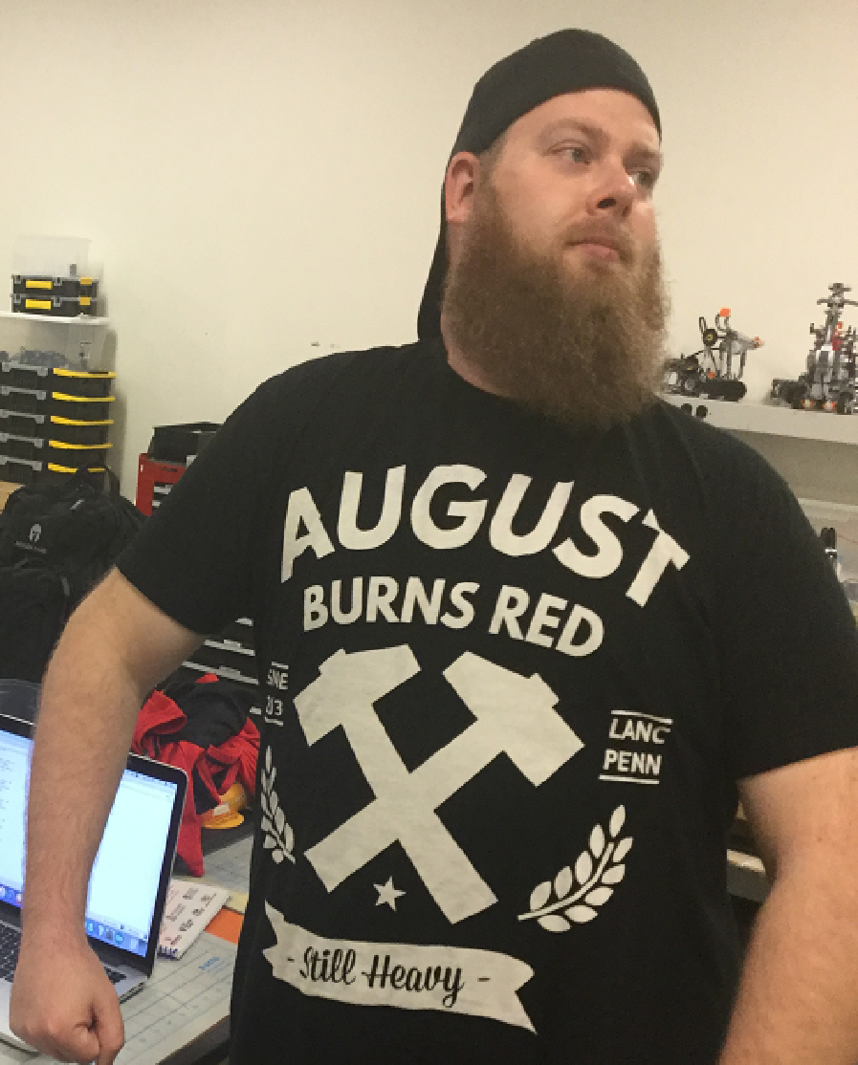
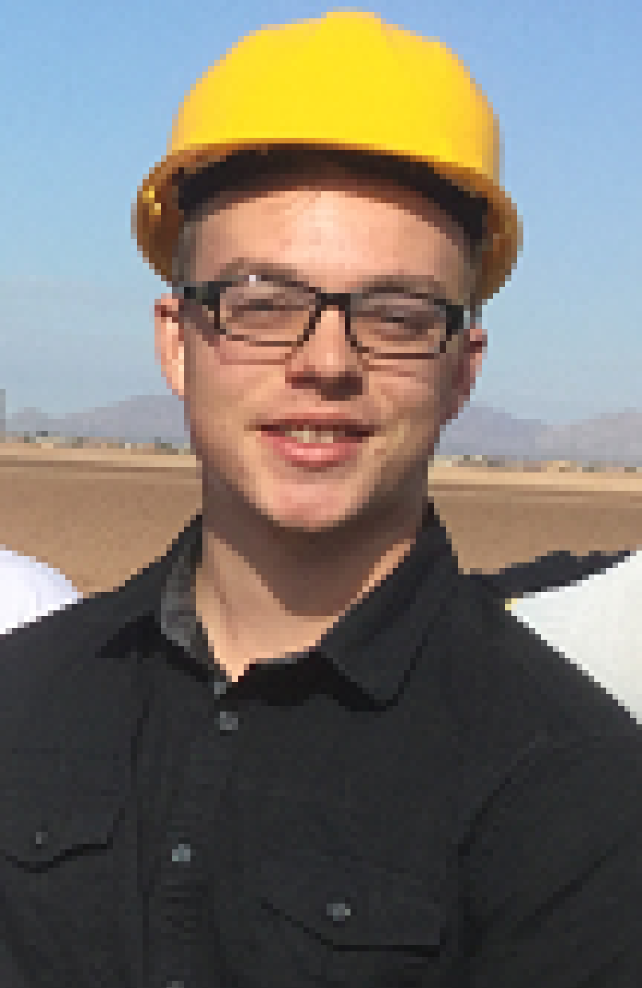
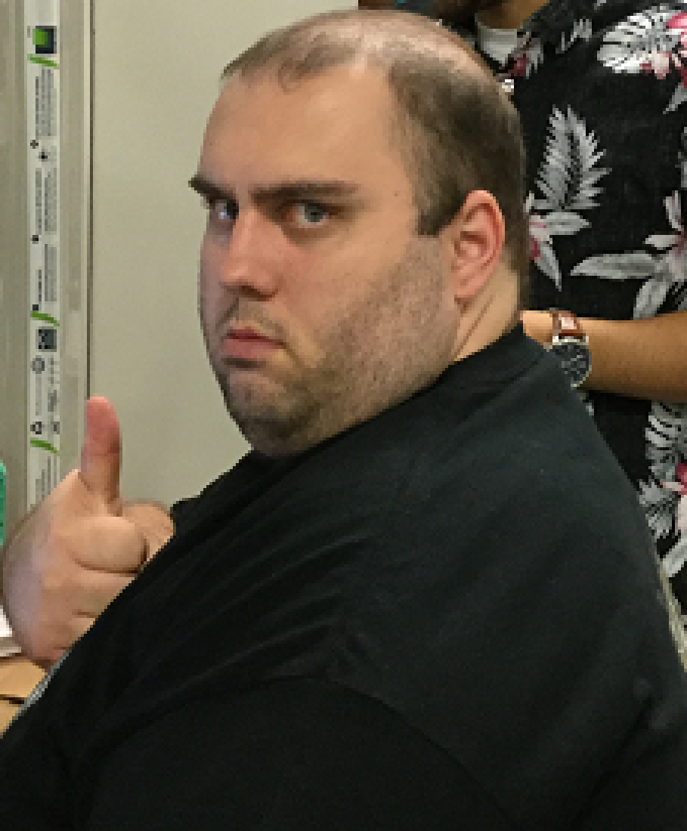
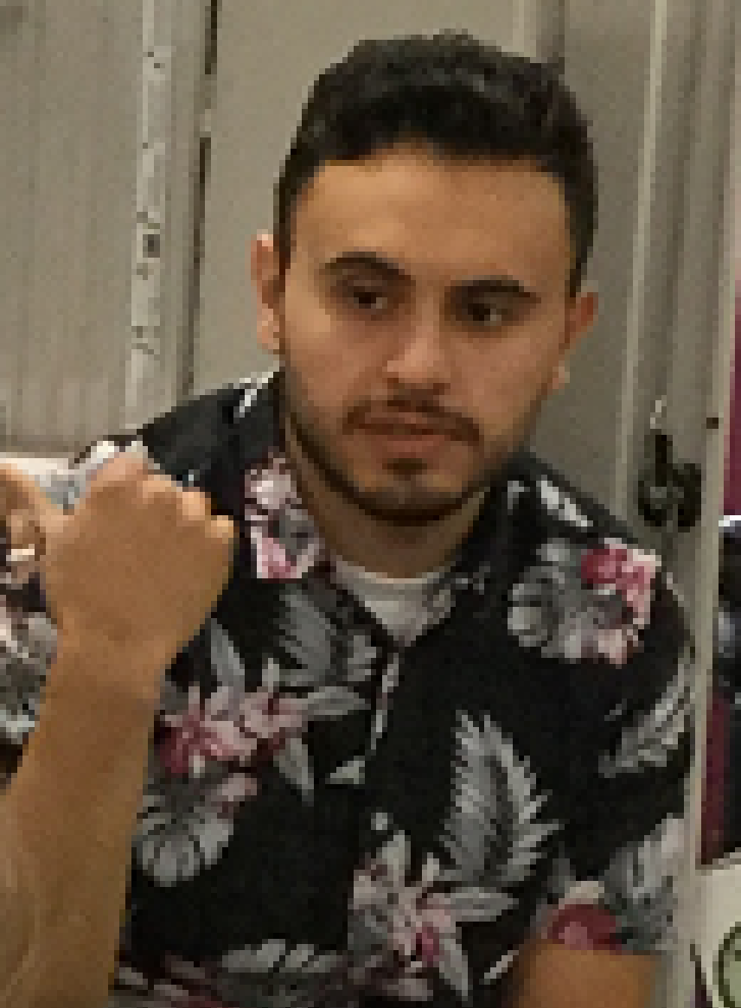
Presented By
Noel
Rojas
Nic
Blum
Austin
Macosky
Stephen
Bakle
Carlo
Hurtado

Slide 3

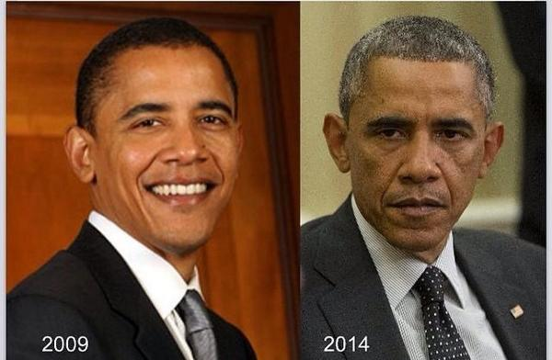
First Semester
Second
Semester

Slide 4





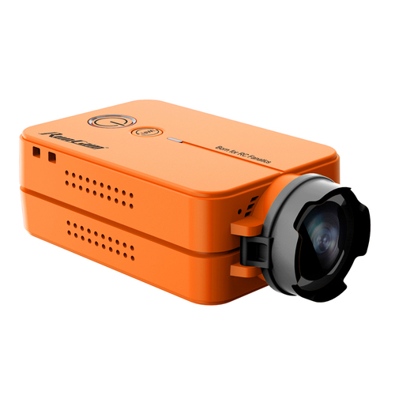


Slide 5

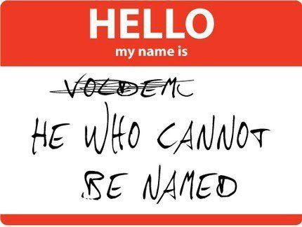

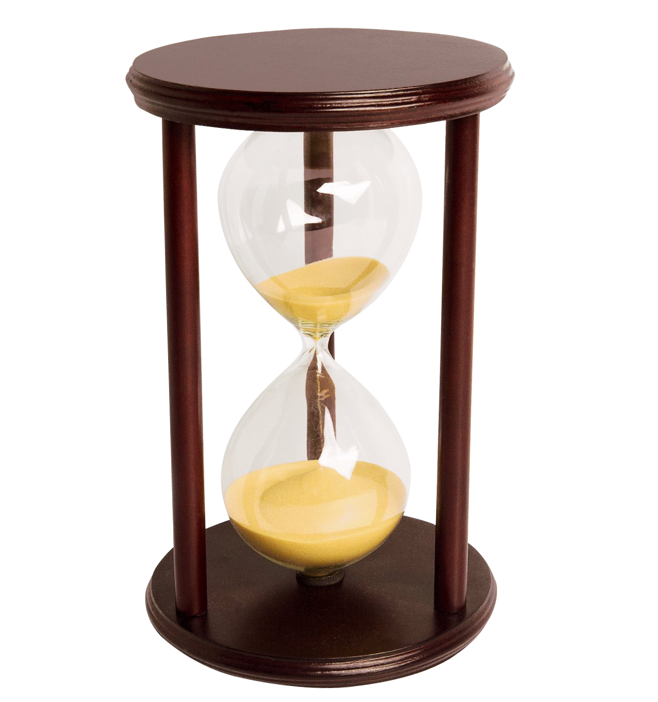
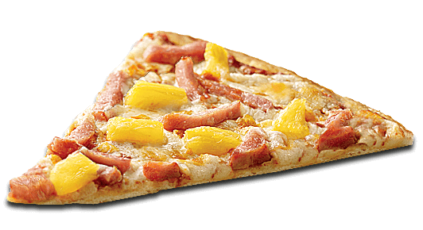

Slide 6
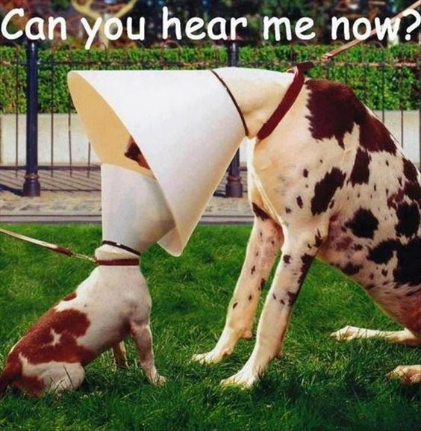
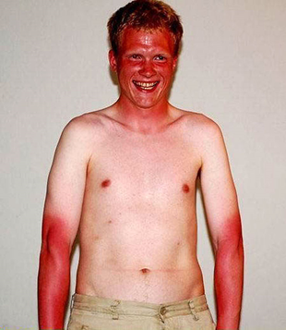

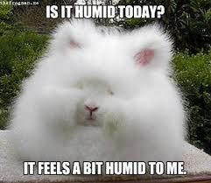
Mission Goals
Measure the following with respect to altitude
  UV light intensity
  Relative humidity
  Sound conduction through the air
Measure atmospheric conditions
Create a payload that can react to external stimuli
Transmit live position and altitude data via HAM radio

Slide 7
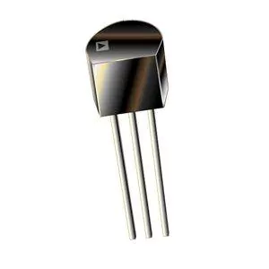
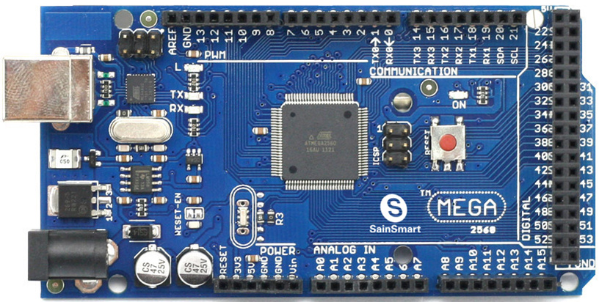
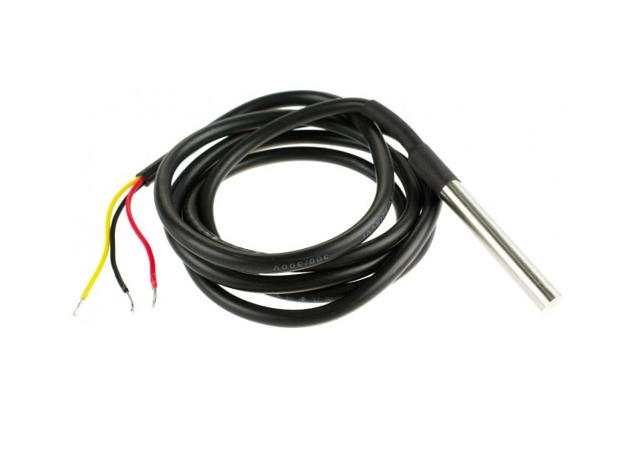
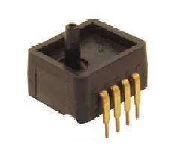
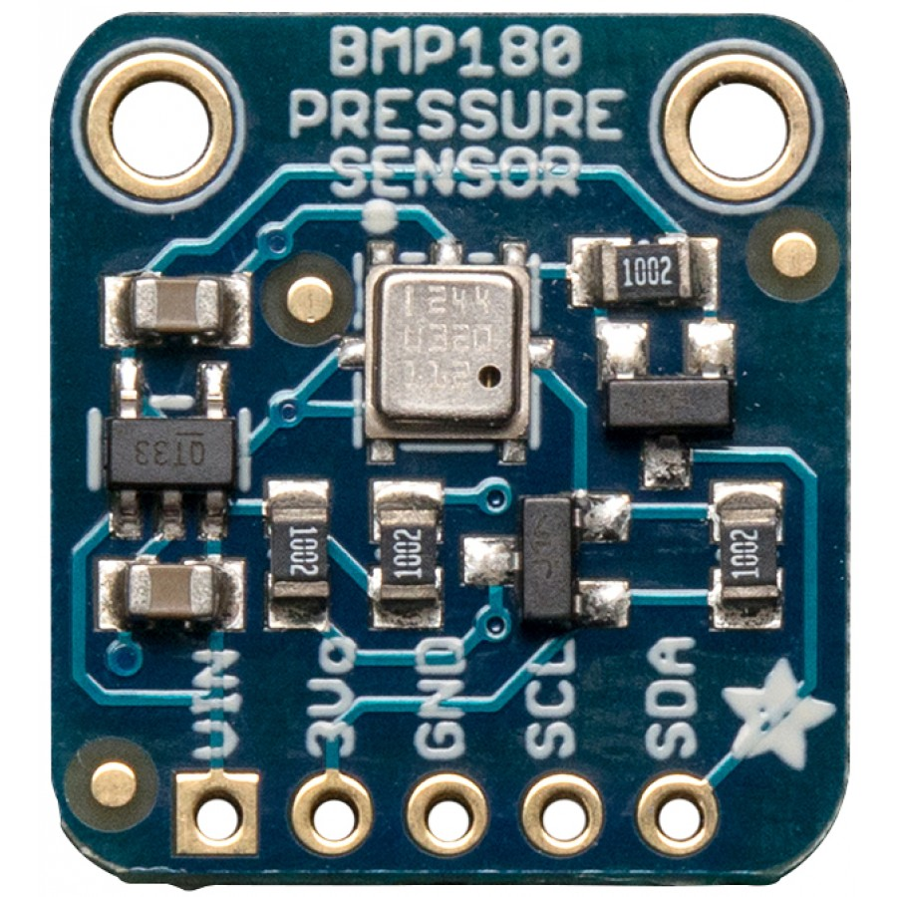
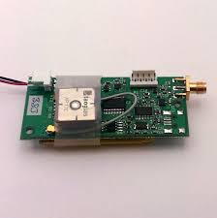
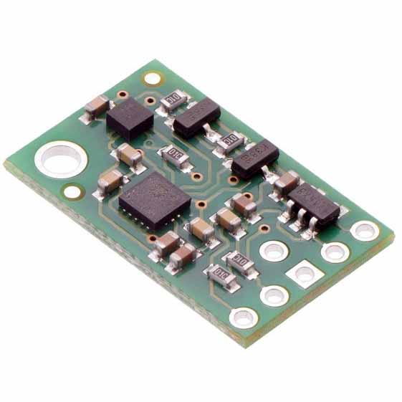
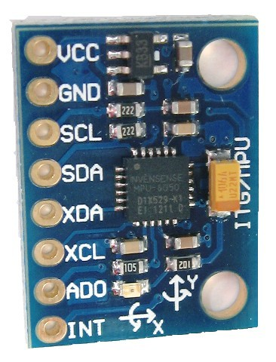
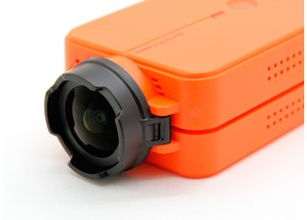
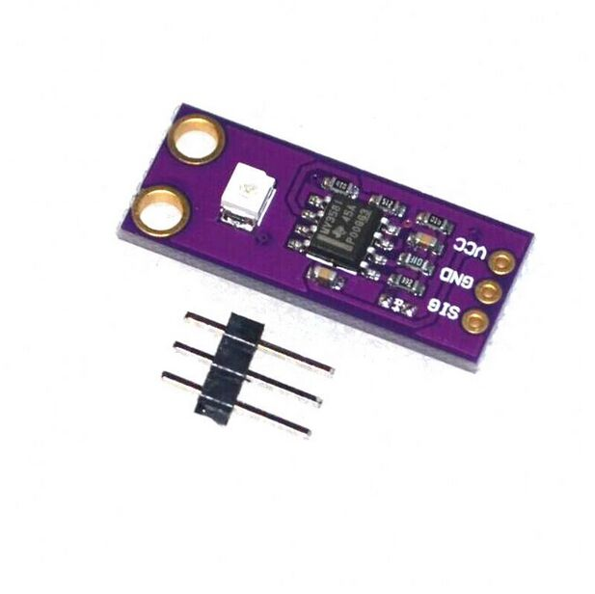
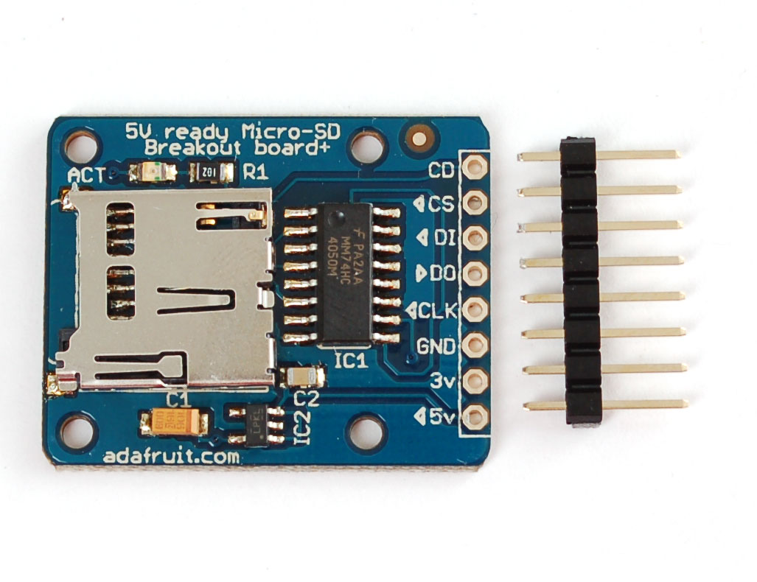
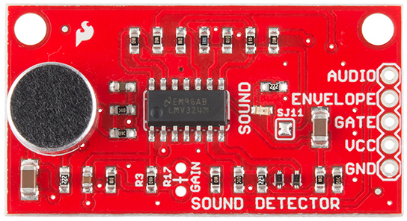
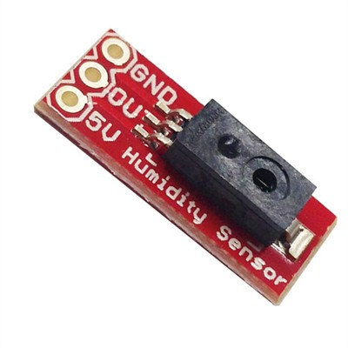
List of Components
ANALOG SENSORS
  TMP36GT9Z – Temperature
  ASDX-A2 – Pressure
  DE-ACCM6G - Accelerometer
  GUVAS12SD – Ultraviolet
  HIH4030 – Humidity Sensor
  Voltage/Current Monitor
DIGITAL SENSORS
  DS18B20 – Temperature
  BMP180 – Pressure
  MPU6050 – Accelerometer/Gyroscope
BOARD
  Arduino Mega 2560
MISCELLANEOUS
  SD Breakout board – (16GB)
  Piezo Buzzer
  LMV324 – Sound Detector
GPS
  BigRedBee - 2 Meter HP GPS
CAMERA
  RunCam2 – (64GB)

Slide 8
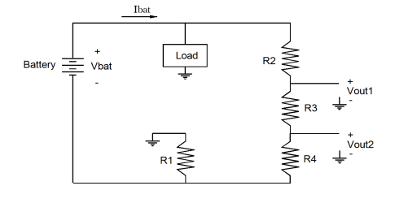
VOLTAGE & CURRENT MONITORING CIRCUIT
Measured as 2 analog sensors via Vout1 and Vout2
Vbat and Ibat calculated with equations based on the analog voltage readings
Provides accurate duration testing

Slide 9
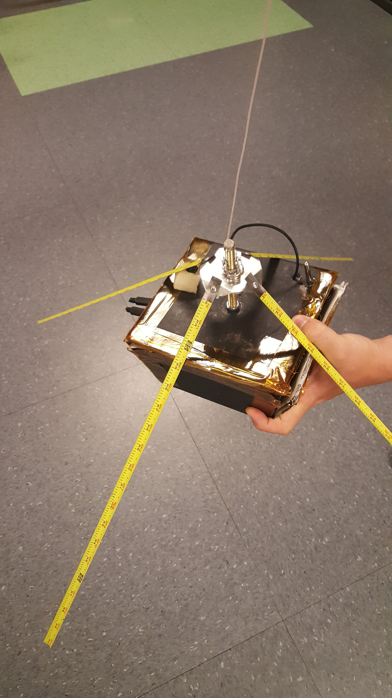
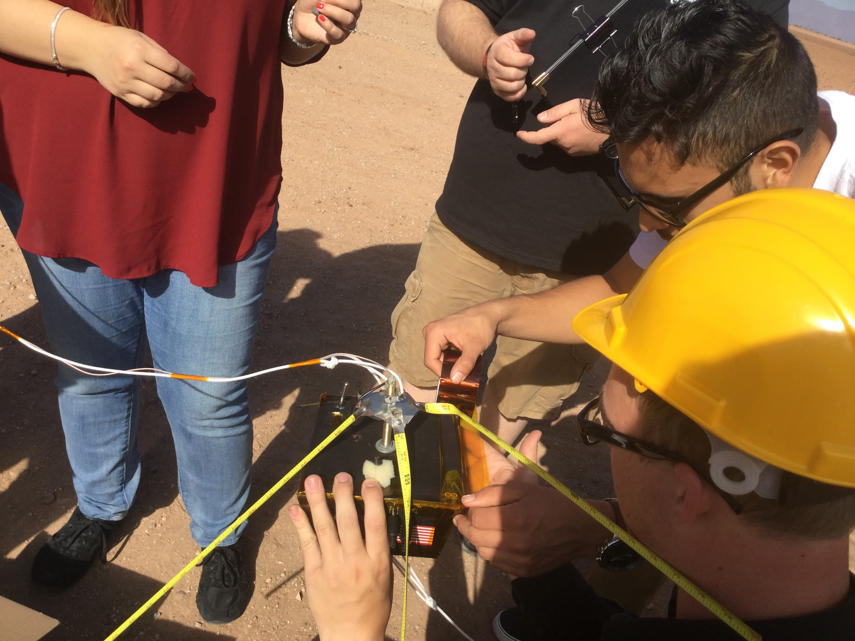
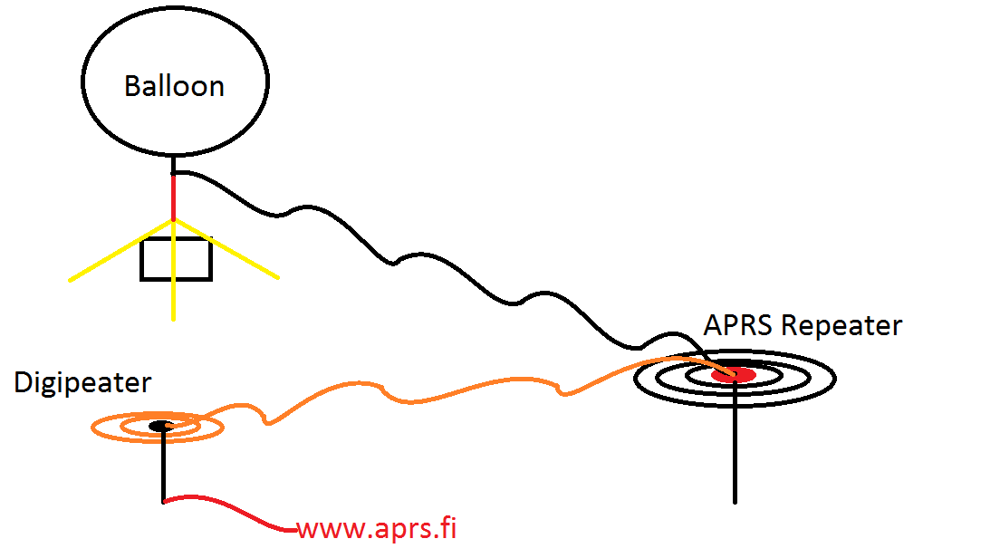
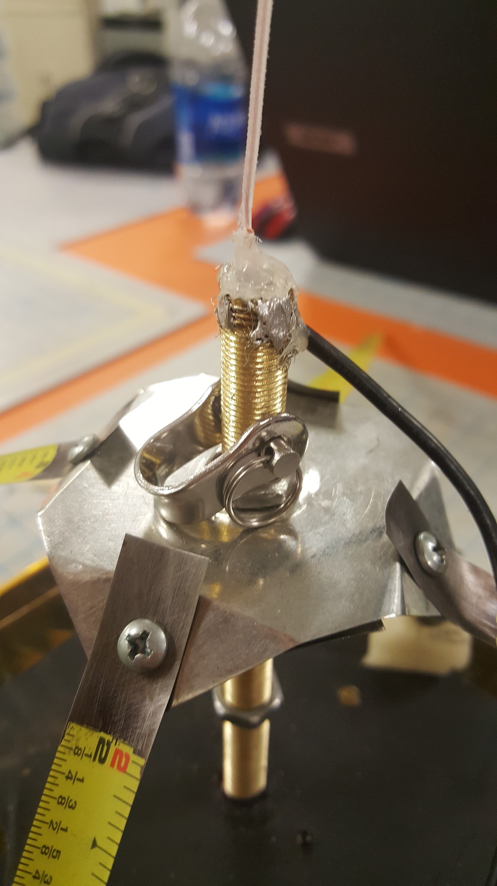
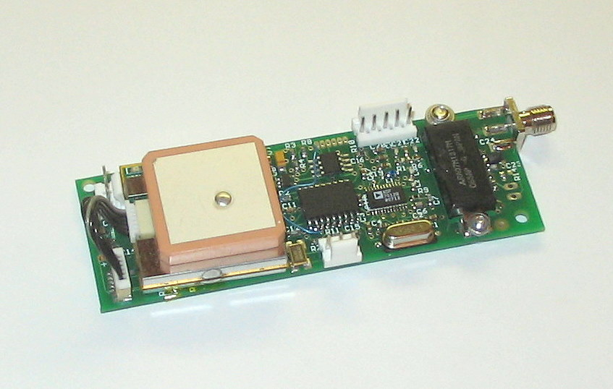
BigRedBee APRS/GPS
KI7JOV-11

Slide 10
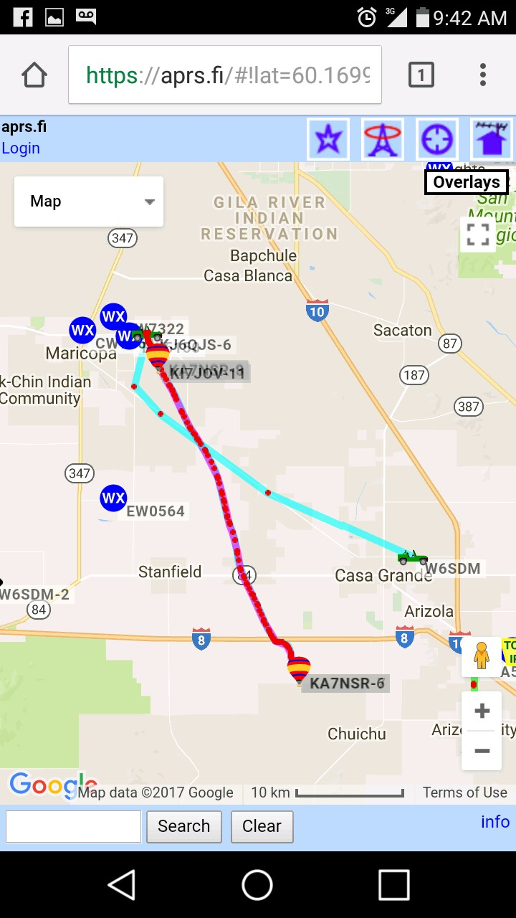
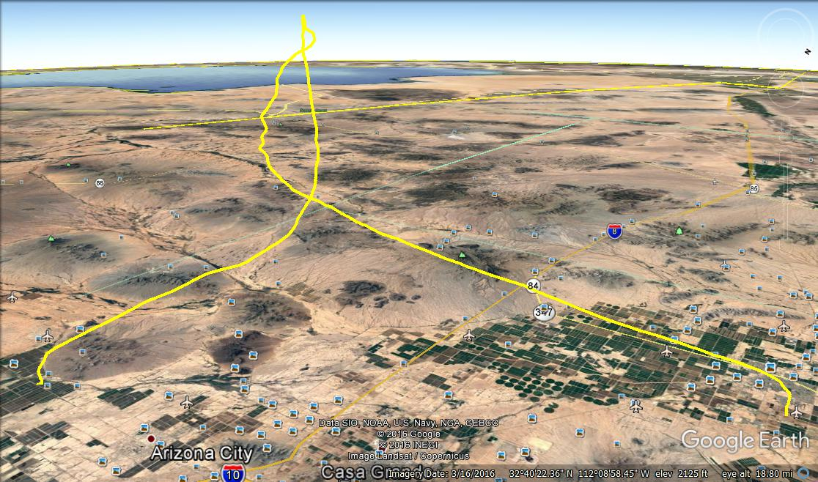
APRS TRACKING

Slide 11

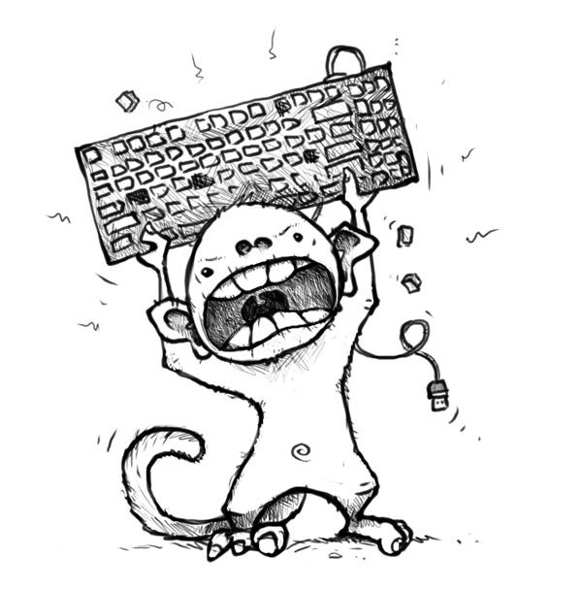
PROGRAMMING
STARTED HERE
<--
ENDED HERE

Slide 12
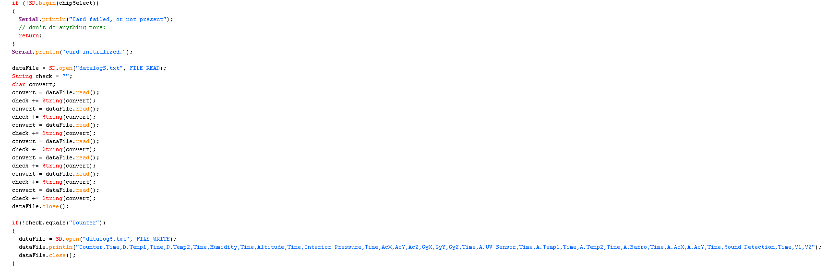
PROGRAMMING

Slide 13

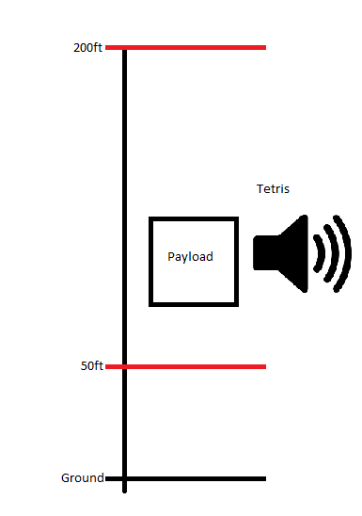
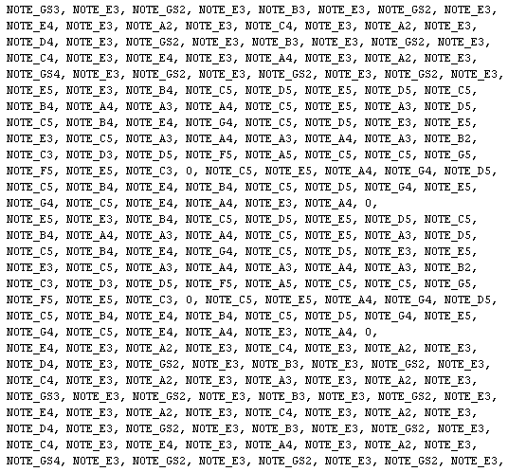

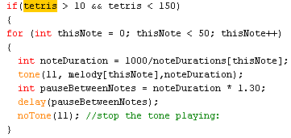
Reacting to external stimuli

Slide 14
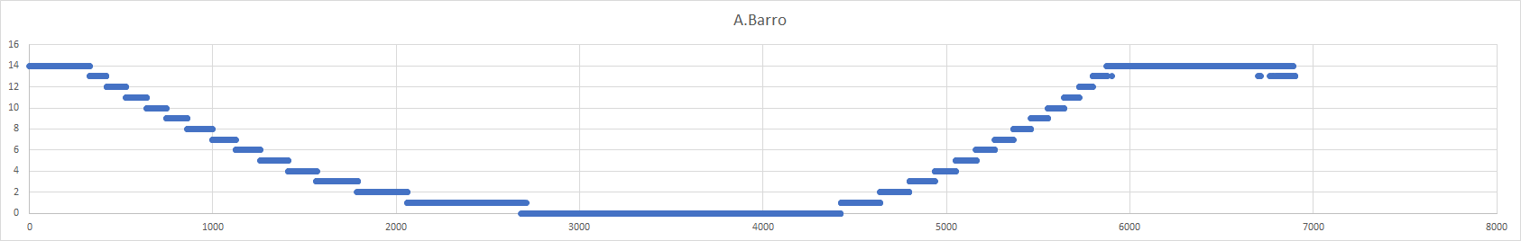
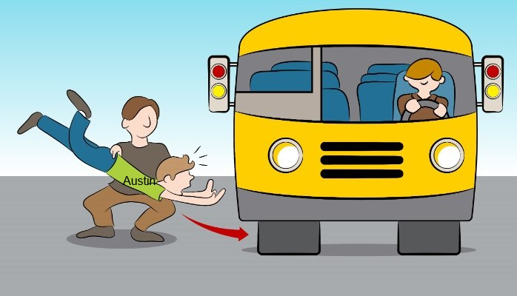
What went wrong with the code
The analog pressure sensor was coded as an integer instead of a double or float.

Slide 15
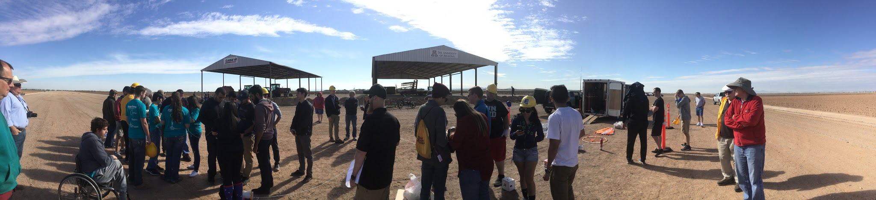
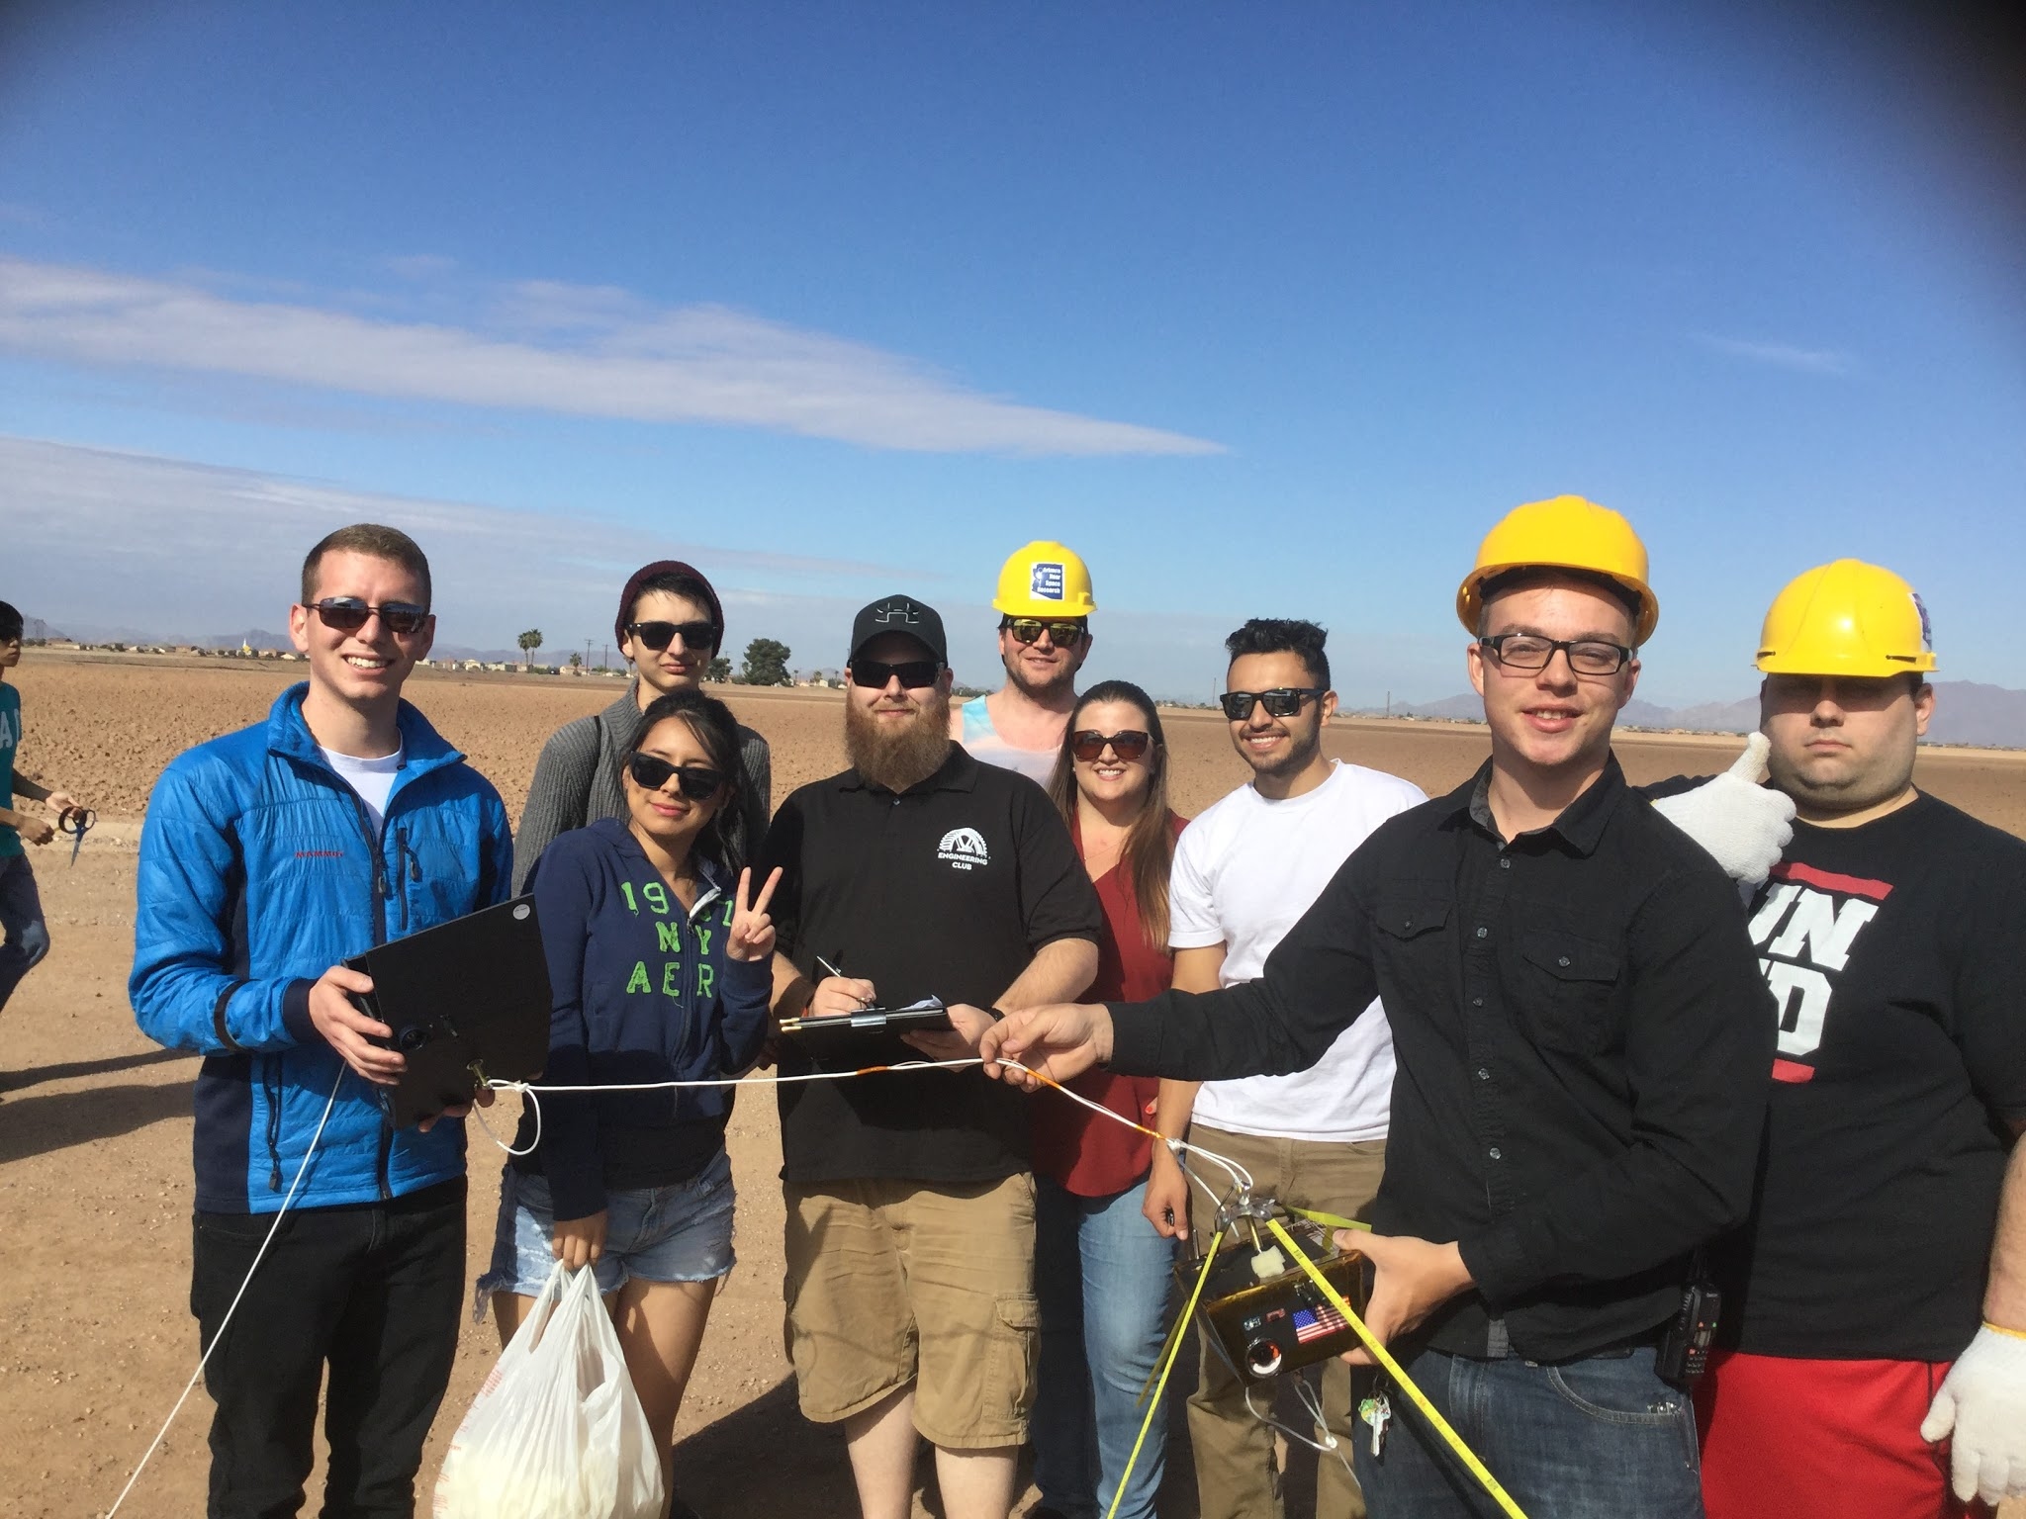
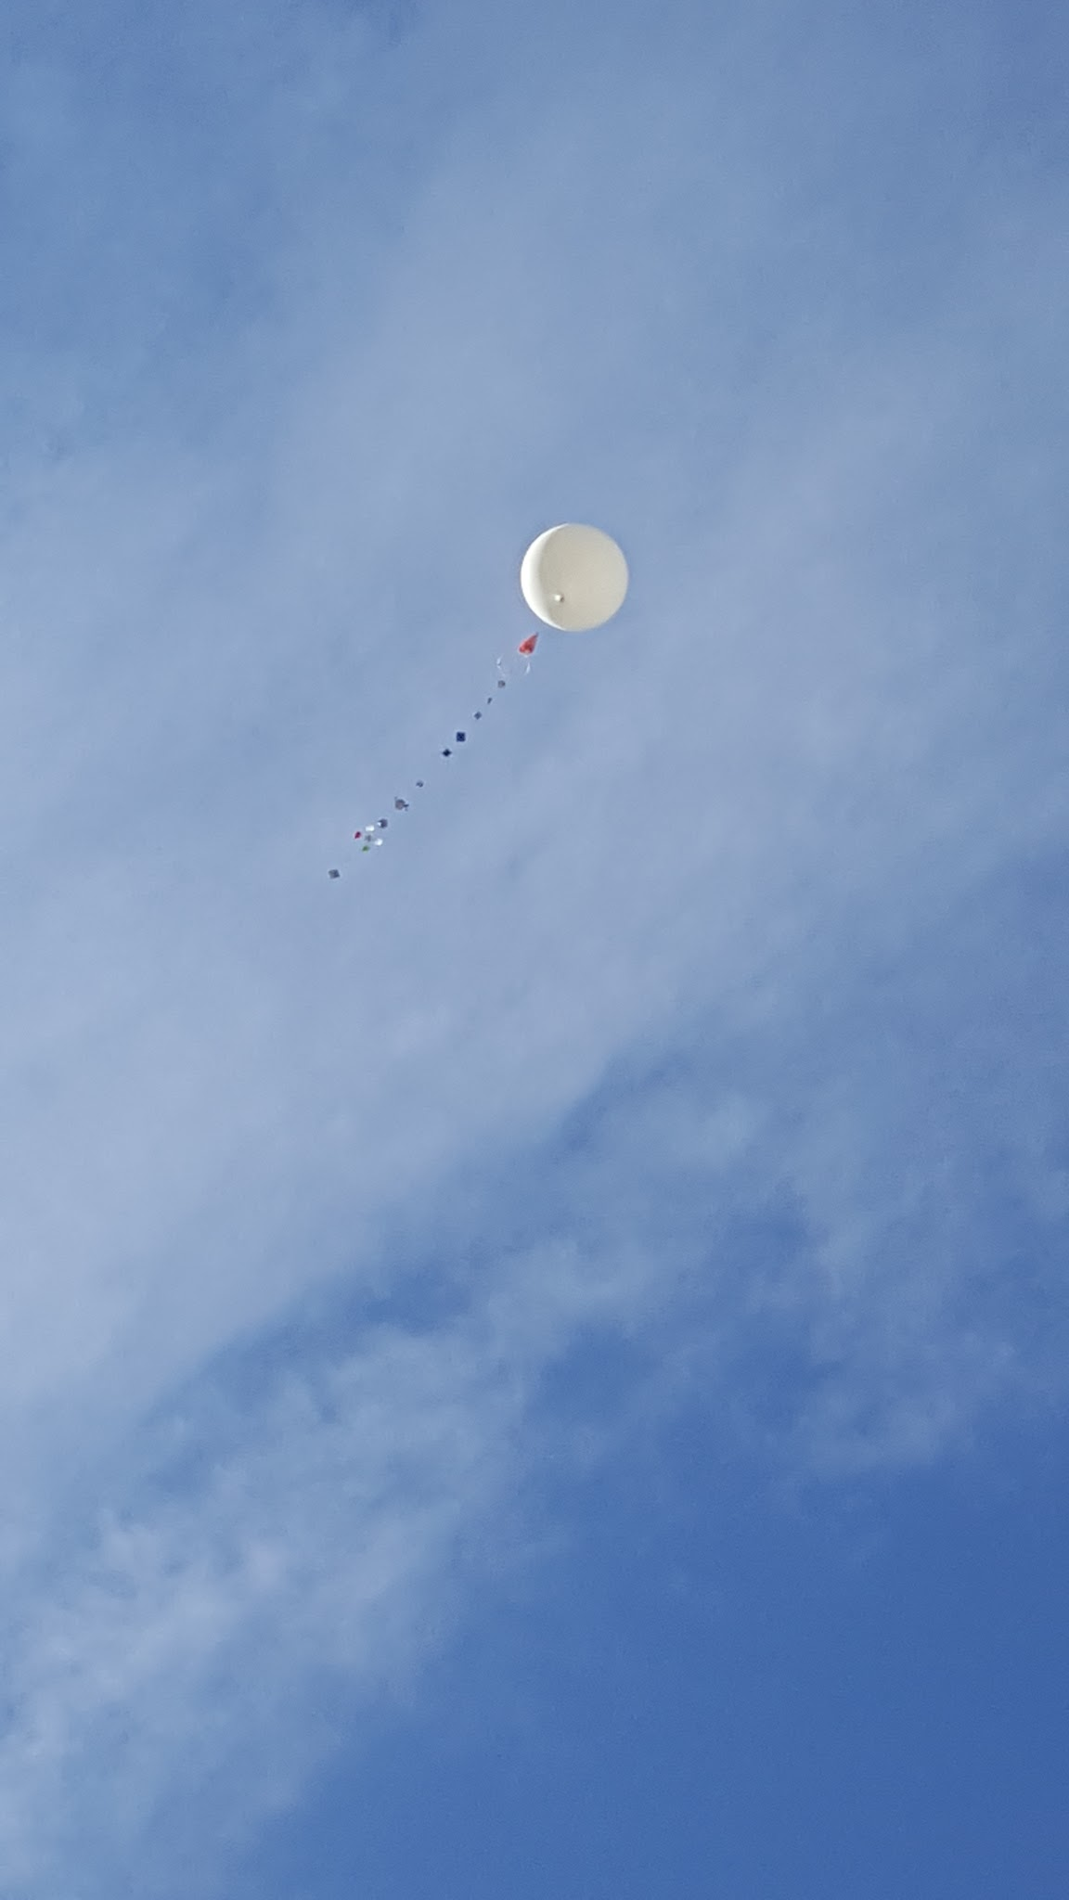

Slide 16
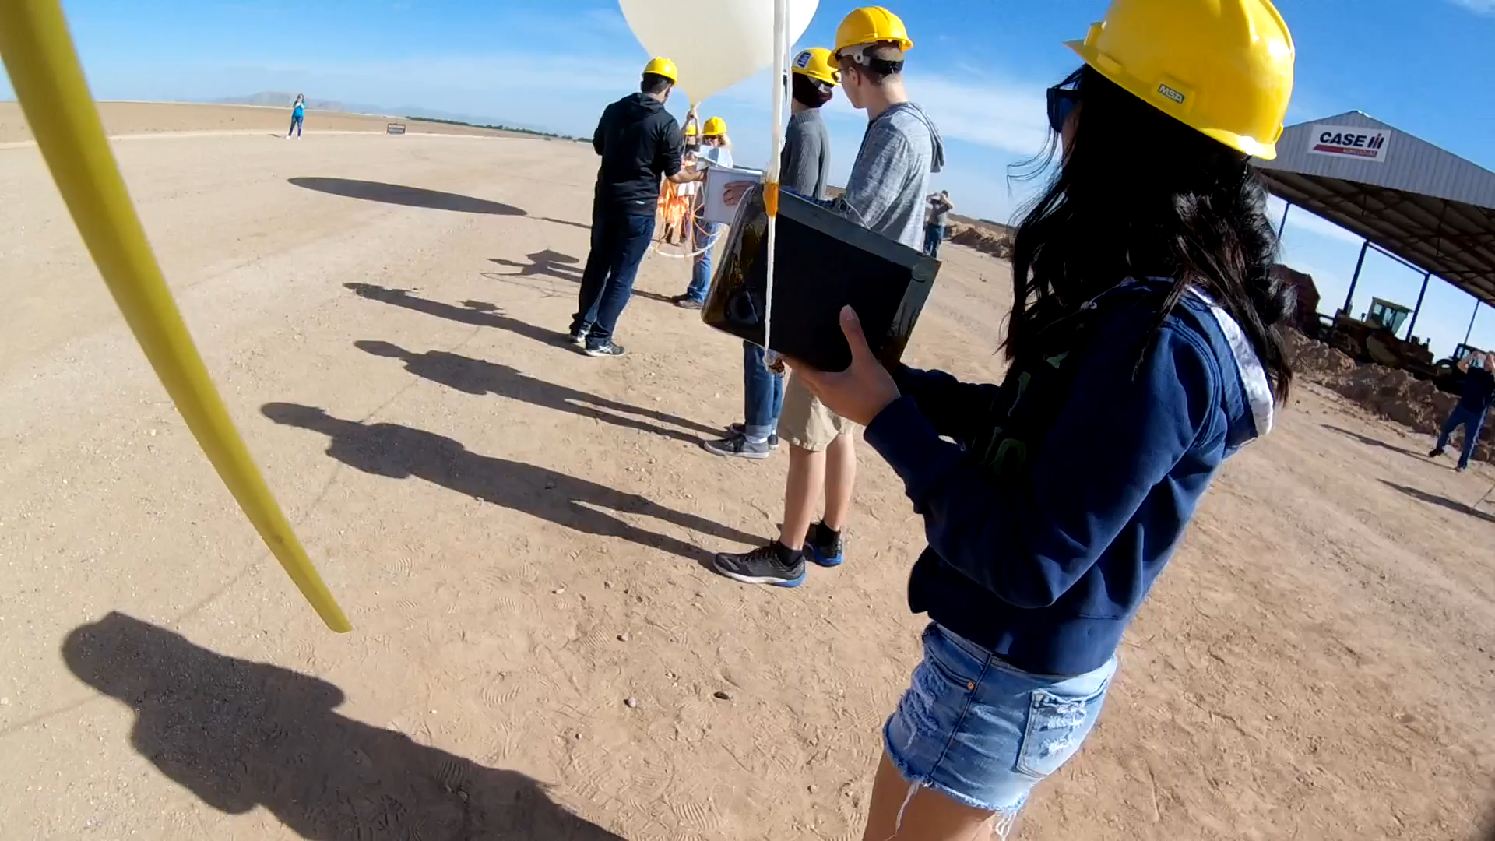

Slide 17
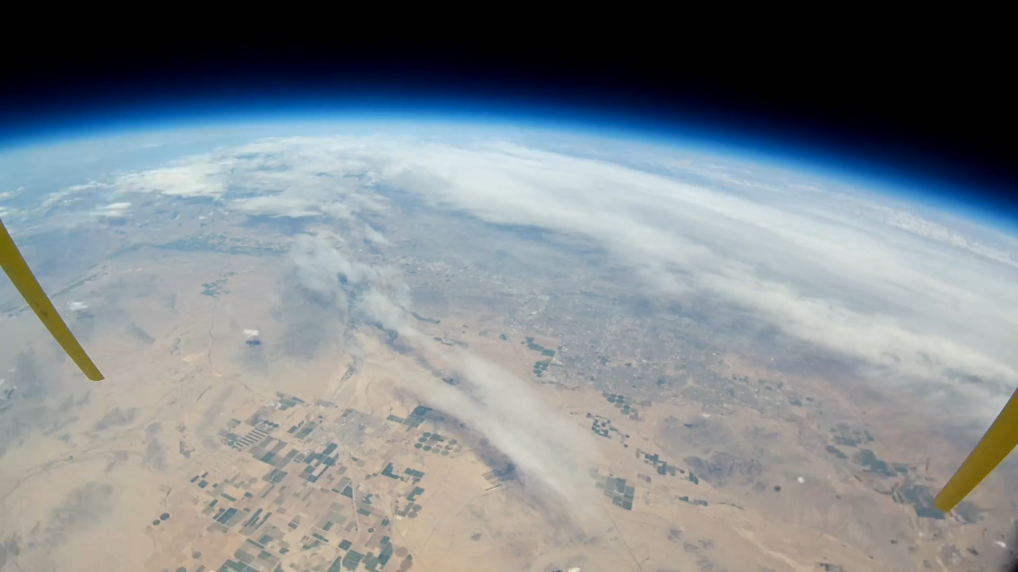

Slide 18
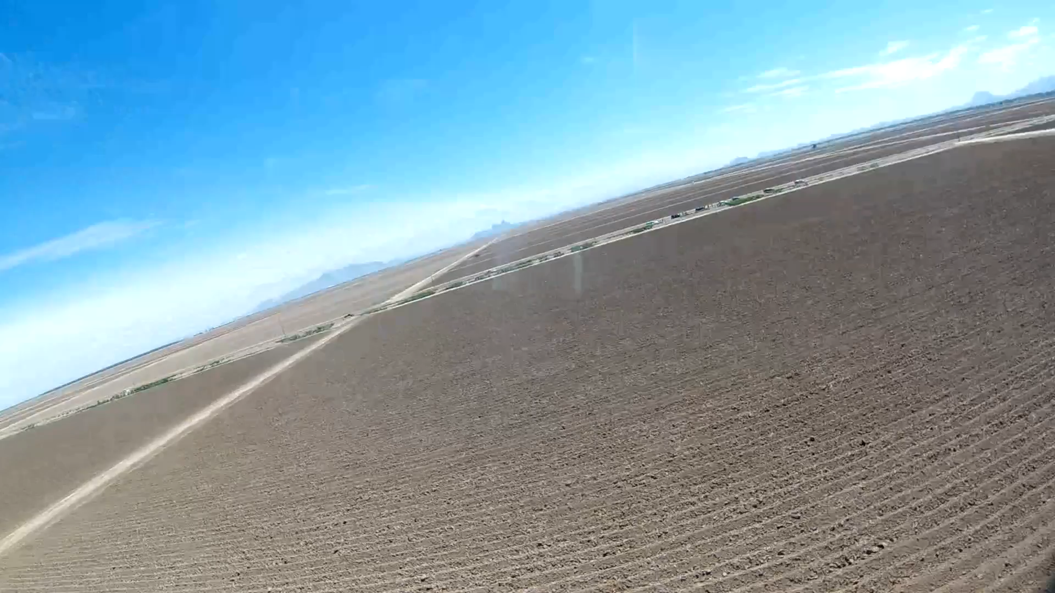

Slide 19
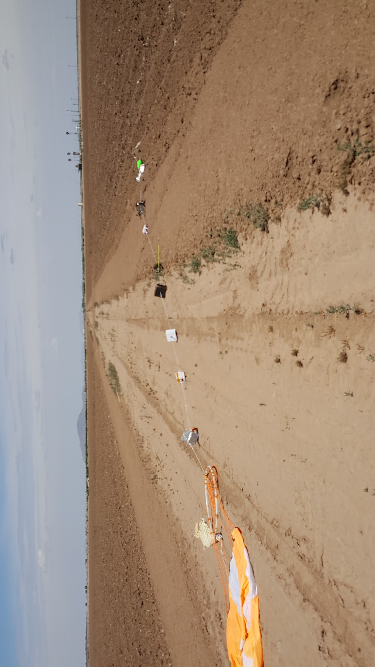
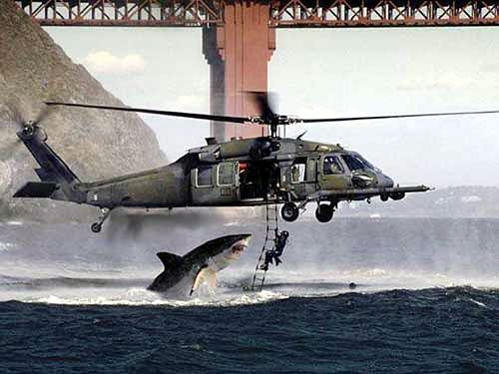
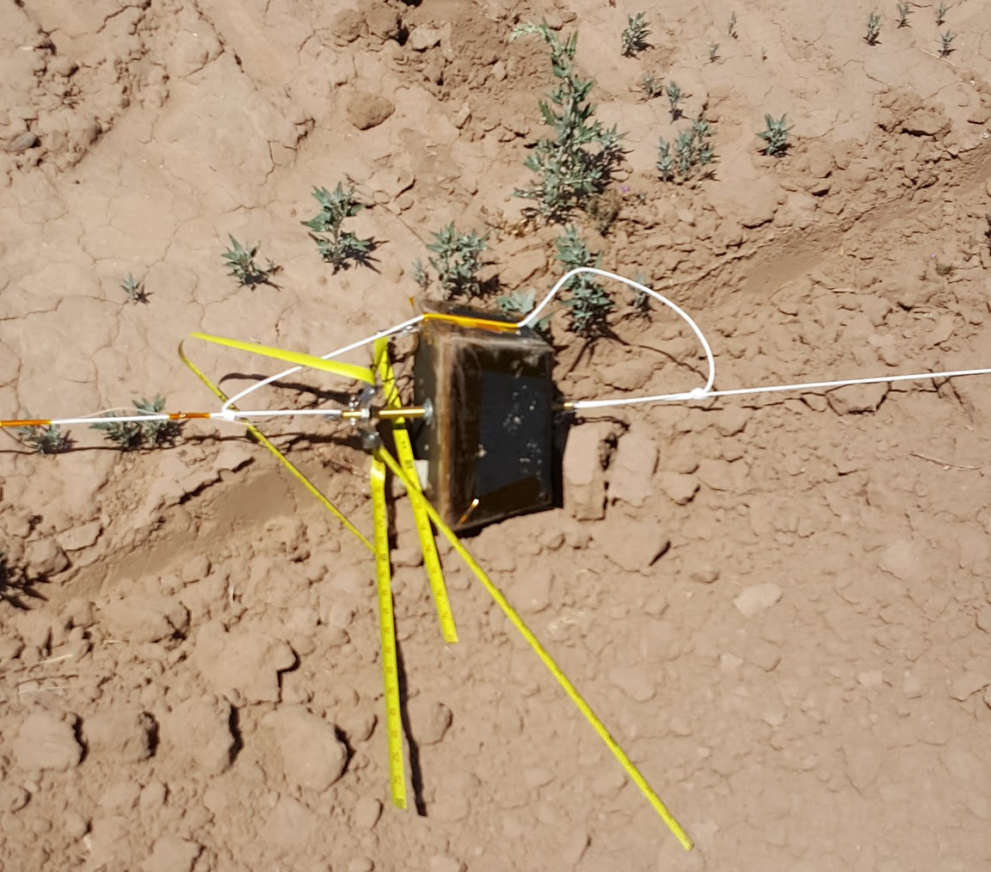

Recovery

Slide 20


Temperature

Slide 21

Altitude

Slide 22





Acceleration

Slide 23


Pressure

Slide 24

UV SENSOR

Slide 25

SOUND

Slide 26

HUMIDITY

Slide 27



Power Consumption

Slide 28
Overview of What We Learned
sound experiment - buzzer was audible in our video moments before burst
uv experiment - at high altitudes there is a dangerous amount of UV radiation
humidity experiment - humidity spike when austin breathed into sensor upon retrieval (because he is full of hot air)
Teamwork and communication - choose to pass together or fail together

Slide 29



SPECIAL THANKS TO...
Our Mentors
Dr. Tim Frank
Rick Sparber
Also
Jack Crabtree
Everyone involved with ANSR

